Slide 1

CAREERBRIDGE
ONLINE JOB PORTAL
YOUR PATH TO PROFESSIONAL SUCCESS !!!

Slide 2
TABLE OF CONTENTS
About The Team
06
Entity-Relationship (ER) Diagram
01
Our Team
02
07
Use Case Diagram
Introduction
03
08
Timeline
Objectives
04
09
Timeline(clickup)
05
10
Functions
Reference

Slide 3

Prototype Nexus
"Welcome to Prototype Nexus, where innovation meets execution. As a dynamic and forward-thinking company, Prototype Nexus is dedicated to turning visionary ideas into tangible realities. Our passion for innovation, cutting-edge technology, and design excellence drives us to create solutions".

Slide 4





OUR TEAM
K. H. D. Gunawardhana (Team Leader) Index :- 14508
W.G.T.K. Wijesinghe
(Team Convener)
Index :- 14506
S. H. I. Madhushan
(Team Member)
Index :- 14504
K. Lohishan
(Team Member)
Index :- 14503
M.A.R.F. Fahama
(Team Member)
Index :- 11132

Slide 5

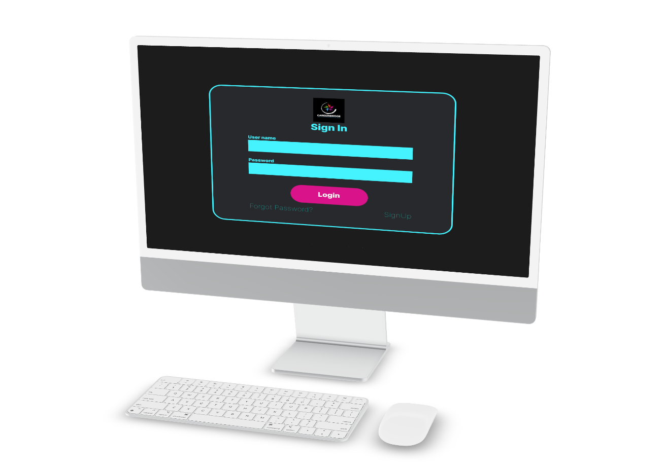



INTODUCTION
OVERVIEW
Our project is a communication platform connecting Company, Job seekers, and Employee. It improves collaboration and transparency in the job search and recruitment process for both job seekers and employers.
01
PURPOSE
An online job portal serves as a bridge between job seekers and employers and offers a wide range of benefits such as efficiency, cost savings, customization and access to a larger talent pool. Its primary purpose is to simplify and improve the job search and recruitment process for all parties involved.
02
AUDIENCE
Jobseekers, Employers and Companies often have different needs. Here we distinct groups based on their goals and requirements. It’s guiding the audience to find Satisfying job role or Identifying the ideal Candidate
03

Slide 6

OBJECTIVES
1. Create a User-Friendly Platform:
Develop a user-friendly and intuitive online job portal that is easy for both job seekers and employers to navigate.
2. Increase Job Listings:
Increase the number of job listings on the platform to provide a wide range of employment opportunities to job seekers.
3. Enhance Search Functionality:
Improve the search and filter functionality to allow job seekers to easily find jobs that match their qualifications and preferences.

Slide 7

OBJECTIVES
4. Enhance Security:
Implement robust security measures to protect user data and prevent fraudulent activities on the platform.
5. Feedback mechanism:
Create a feedback mechanism for users to provide them with information about their experience with the platform, allowing for continuous improvement.

Slide 8

FUNCTIONS
Job Posting
Apply for jobs
Checking CVs/resumes
User Authentication and Profiles
Job Search

Slide 9
User Authentication and Profiles
Users can create accounts and log in.
User profiles allow for personalization and storing essential information.
Different user roles: Job Seekers and Employers.

Slide 10

Job Search
Job seekers can search for job listings based on various criteria like industry, salary, and job type.

Slide 11

Job Posting
Employers can post job openings, providing detailed descriptions, requirements, and application instructions.

Slide 12
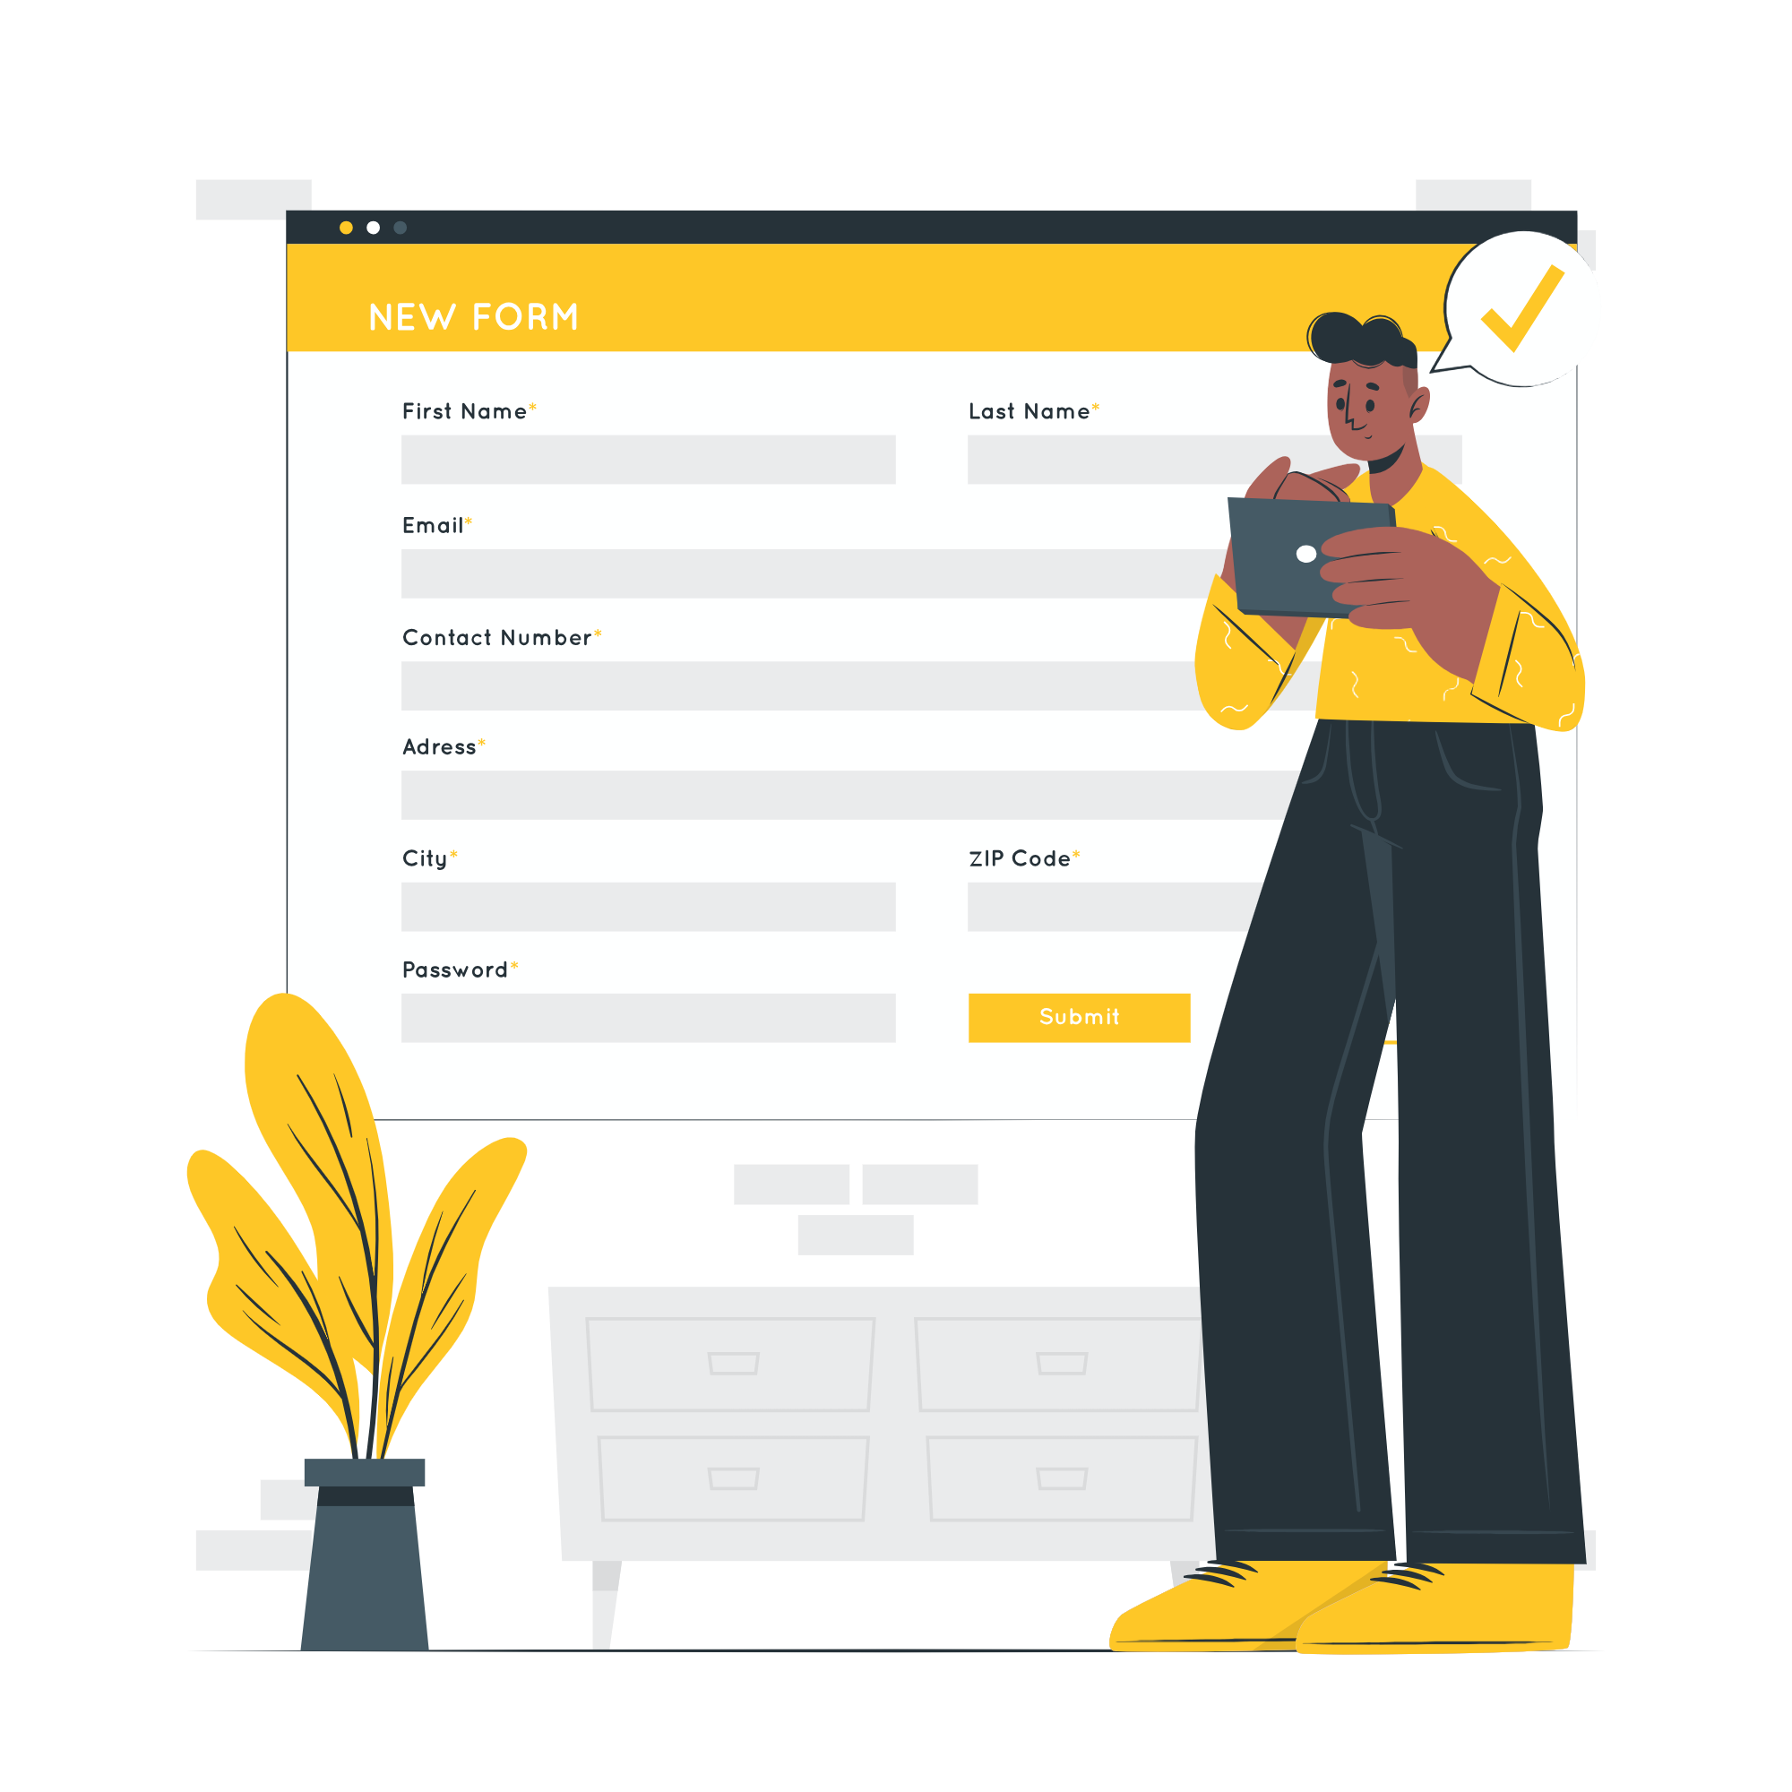
Apply for jobs
Job seekers can upload their resumes/CVs by using job portal.

Slide 13

Checking CVs/Resumes
Employers can view and download applicant resumes/CVs by using job portal.

Slide 14
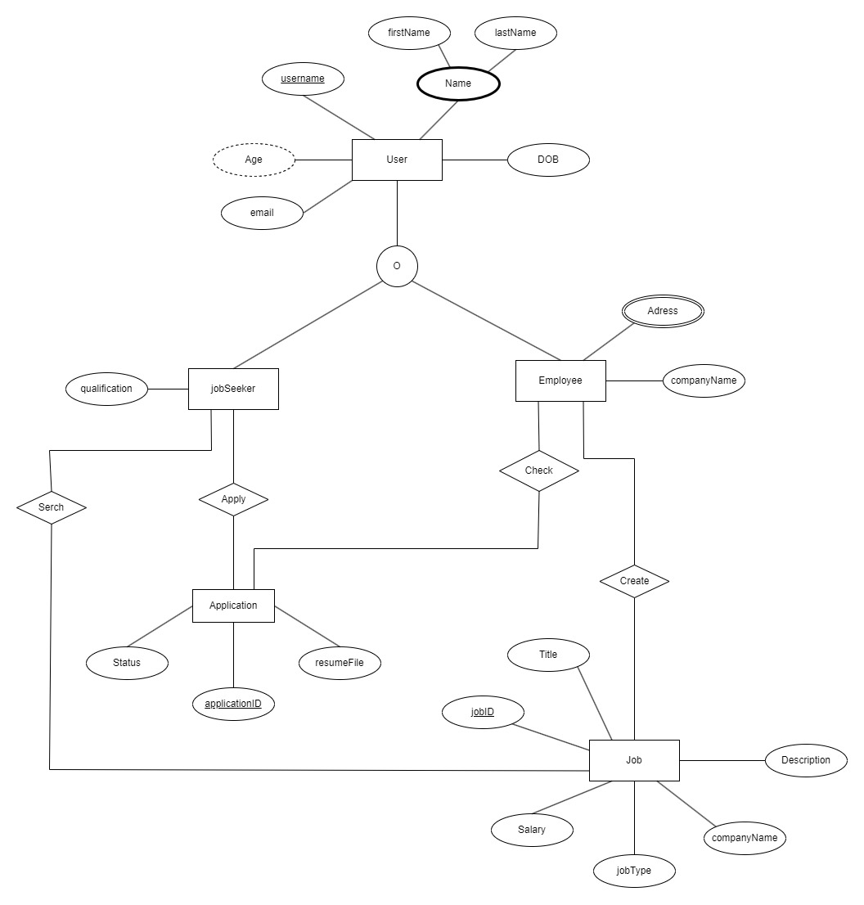
Entity-Relationship (ER) Diagram
This section presents an Entity -Relationship (ER) diagram that visually represents the structure and relationships within the database of our job portal. The ER diagram offers a clear and concise overview of how different data entities are interconnected, providing valuable insights into data organization and database design.

Slide 15
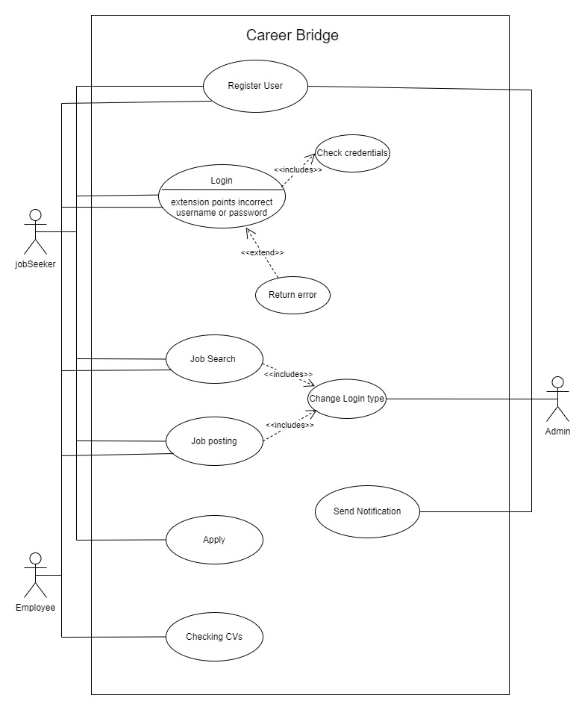
Use Case Diagram
This section presents a Use Case Diagram that provides a visual representation of the interactions between various actors and the functionalities of our job portal system. The diagram showcases the core use cases that demonstrate how different users (actors) engage with the platform, highlighting the key features and user experiences.

Slide 16
Milestone 3
Milestone 4
Milestone 5
Assignment 01
Proposal and Presentation.
12th of September 2023
Discussion meeting based on Balasmiq and Figma.
20th of September 2023
Assignment 02
Prototype Creation and Presentation.
25th of September 2023
Milestone 2
Milestone 6
Topic Selection.
19th of August 2023
Final Test Run.
20th of October 2023
TIMELINE
Milestone 1
Milestone 7
First Meeting for assign a Group Leader.
19th of August 2023
Assignment 03
Full Report and Viva
25th of October 2023
Milestone 0
Preparation for the Group Project.
17th of August 2023

Slide 17
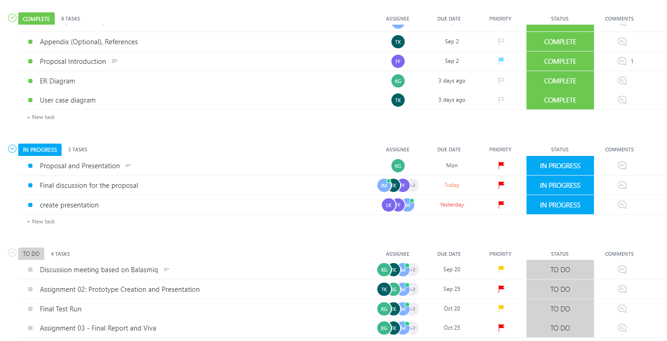
TIMELINE(Clickup)

Slide 18




REFERENCE
1. LinkedIn: LinkedIn
2. Indeed: Indeed
3. Glassdoor: Glassdoor
4. Monster: Monster
5. CareerBuilder: CareerBuilder
6. SimplyHired: SimplyHired
7. ZipRecruiter: ZipRecruiter
8. Snagajob: Snagajob
9. Dice: Dice
10. Idealist: Idealist
11. USAJOBS: USAJOBS
12. Job Hunder: Job Hunder

Slide 19
Thank you so much !

